Slide 1
CSS Grid
Introduction to CSS
Grid Layout
Timothy Ott

Slide 2
Why use CSS Grid?
You can place your content wherever you want on the page, including whitespace.
No need to change the markup order or add extra markup to do so.
Work with both rows and columns simultaneously.
No floats or clears.
Change the layout of content based on screen size using only CSS media queries.
No outside framework necessary.

Slide 3
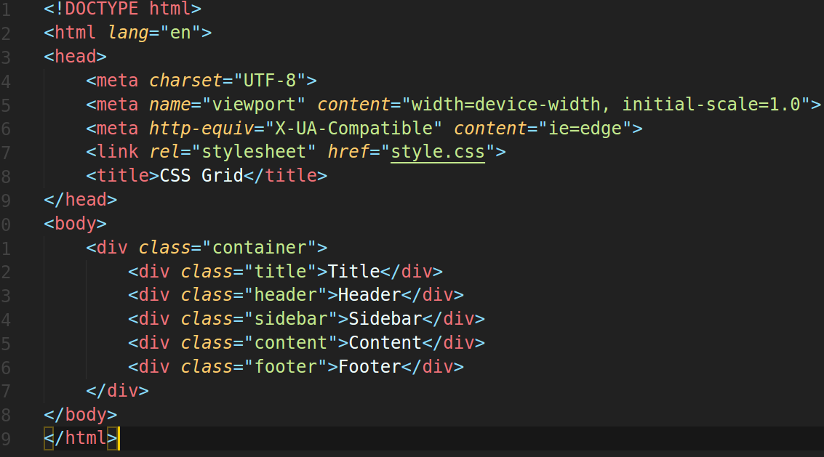
Our HTML

Slide 4
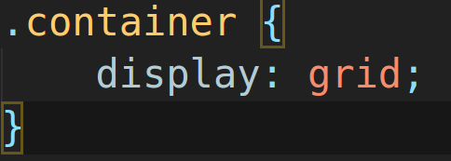
Declaring the grid

Slide 5
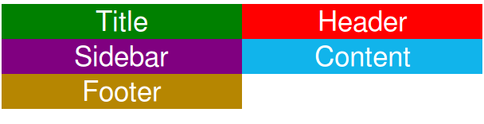
Adding columns to the grid

Slide 6

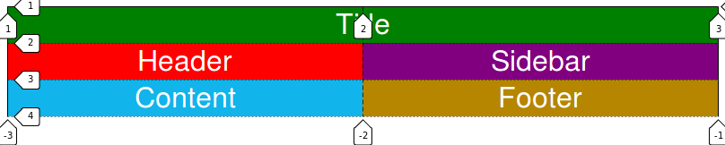
Spanning multiple columns

Slide 7
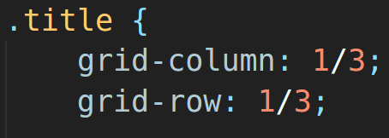
Spanning multiple rows

Slide 8
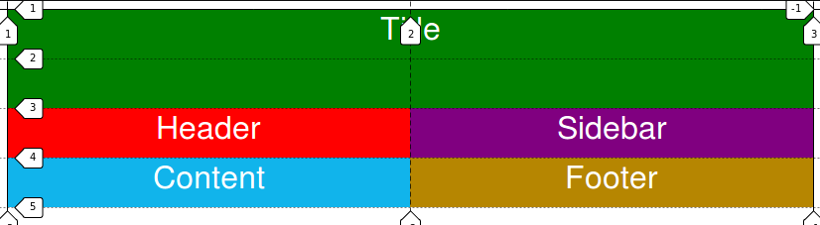

Slide 9
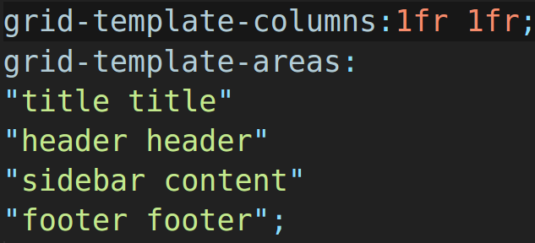
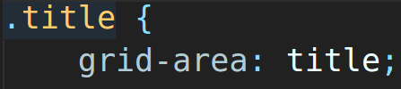
There is a better way!

Slide 10
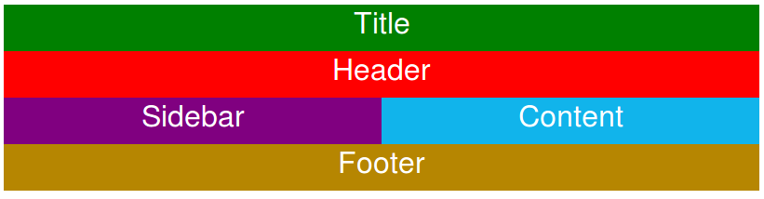

Slide 11
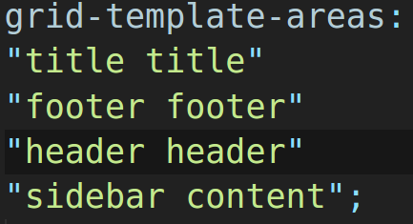
Moving content is simple this way!

Slide 12
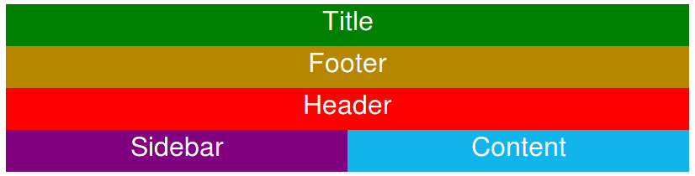

Slide 13
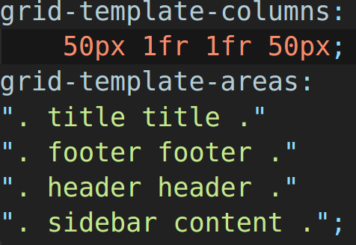
What about whitespace?

Slide 14


Slide 15

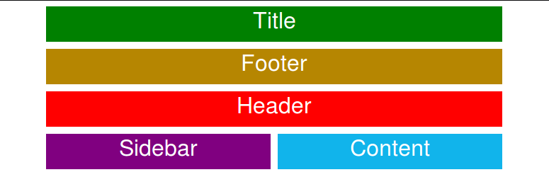
Margins between content

Slide 16
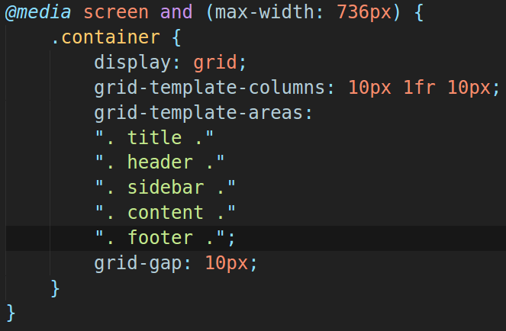
What about responsiveness?

Slide 17
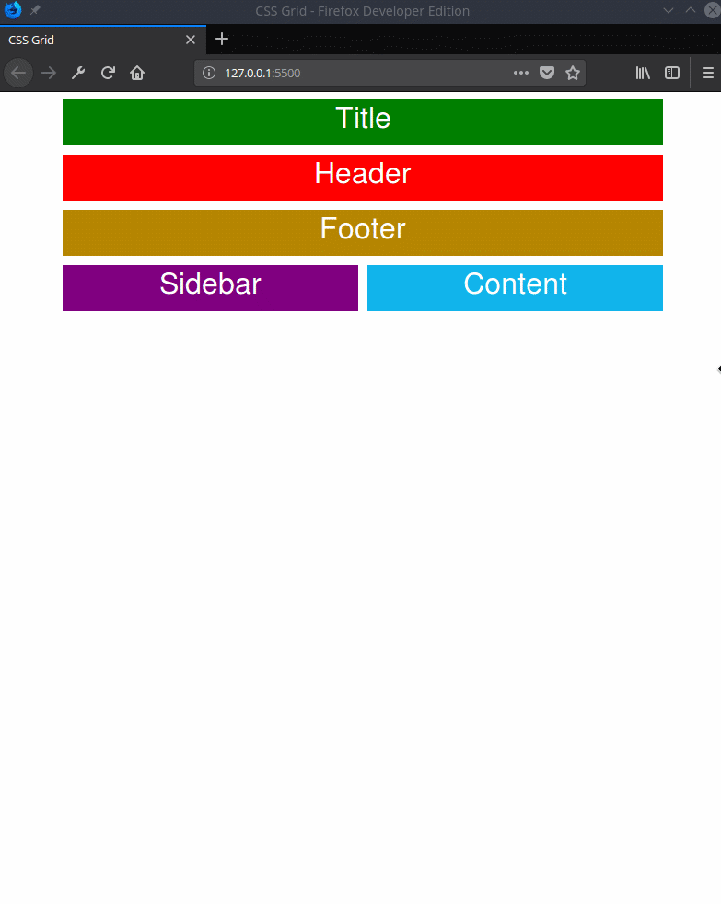

Slide 18
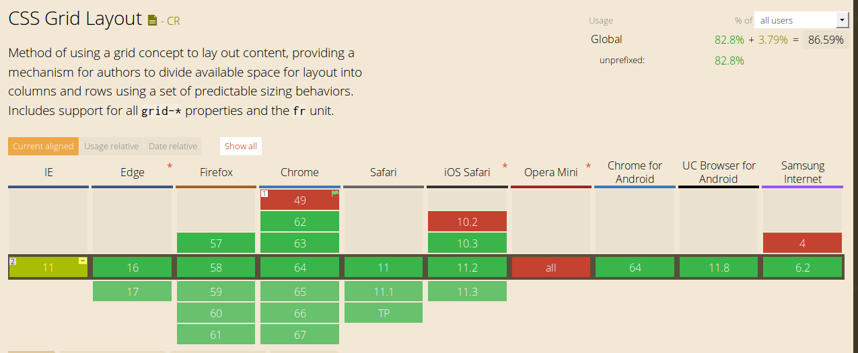
Browser Support?

Slide 19
Resources
https://gridbyexample.com/
https://css-tricks.com/snippets/css/complete-guide-grid/
https://mozilladevelopers.github.io/playground/css-grid/
https://www.w3schools.com/css/css_grid.asp

